Slide 1

SELF-BALANCING BICYCLE USING REACTING WHEEL WITH IMPROVING STABILITY
Batch Members:-
UNDER THE GUIDANCE OF
Dr .R. ILANGO, M.Tech., Ph.D.,
Professor
Electrical and Electronics Engineering
K. Ramakrishnan College of Engineering,
An Autonomous Institution
Samayapuram, Tiruchirappalli – 621 112
A. ARI RAM RAJA | (811519105301)
M. GOKULA KRISHNAN | (811519105302)
P. PREM KUMAR | (811519105305)
D. SRIRAM | (811519105308)
C. LALITHRAJ | (811519105501)

Slide 2
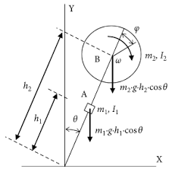
INTRODUCTION
The idea is to make it balance by rotating a reaction wheel with a motor creating a torque with the moment of inertia making the bicycle counteracts its own weight. The acceleration of the wheels is then adjusted relative to the angle between the bicycle and the horizontal plane to keep the bicycle stable.
The experience of controlling motors and handling signals can benefit later projects since similar problems exists in many areas. Examples of areas where this technology is useful are for designing Segway’s, rockets and aircrafts etc.

Slide 3

BASIC CONCEPTS IN SELF BALANCING BICYCLE
The most suitable shape of a reaction wheel is a ring because it provides the greatest moment of inertia per mass that will result in a decreased acceleration.
A PID-controller is the most commonly used controller in the industry. Since Pico Pi includes a built in a PID-function within its libraries it will be used in this project. The PID-function has three parameters KP, KI, and KD that will be choose experimentally.
The measured angle is treated with a PID algorithm, and output generated is scaled to a corresponding voltage and fed to the motor controller. The motor controller then outputs a voltage to the DC motor.
In this project a brushed DC motor was used. A brushed motor means that it rotates internally.

Slide 4
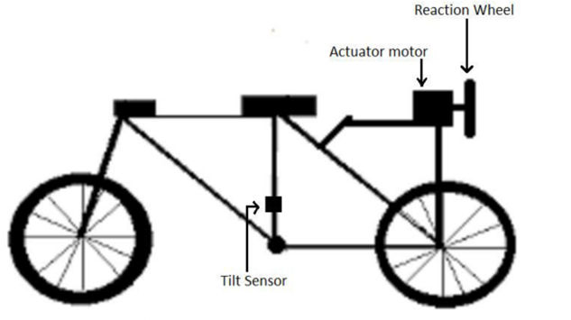
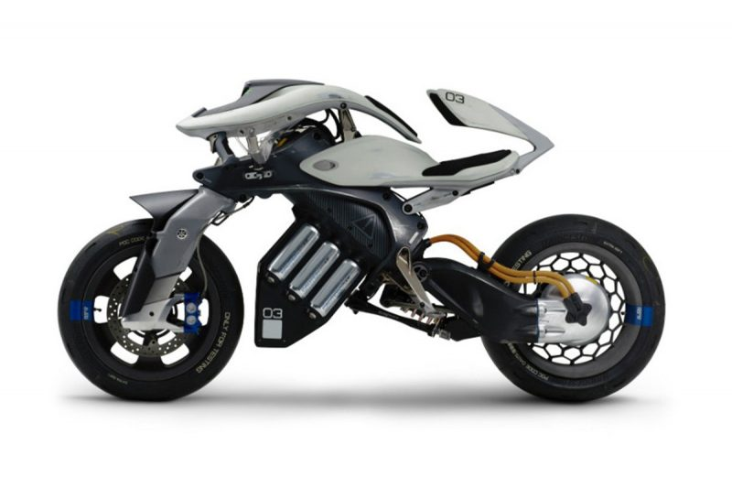
MODEL DIAGRAM
The bicycle is designed to have all of its components within its sides with the sides acting as a protective shell and its corner as good balancing points. The shell will consist of six plates that make up the bicycles sides that will be laser cut from acrylic glass with a thickness of three millimeter. Acrylic glass was chosen because of its low density and good enough yield strength.
The dynamic model of a bicycle is based on the equilibrium of gravity and centrifugal force. A simplified model for balancing is derived using the Lagrange method and neglecting force generated by the bicycle moving forward and steering.

Slide 5
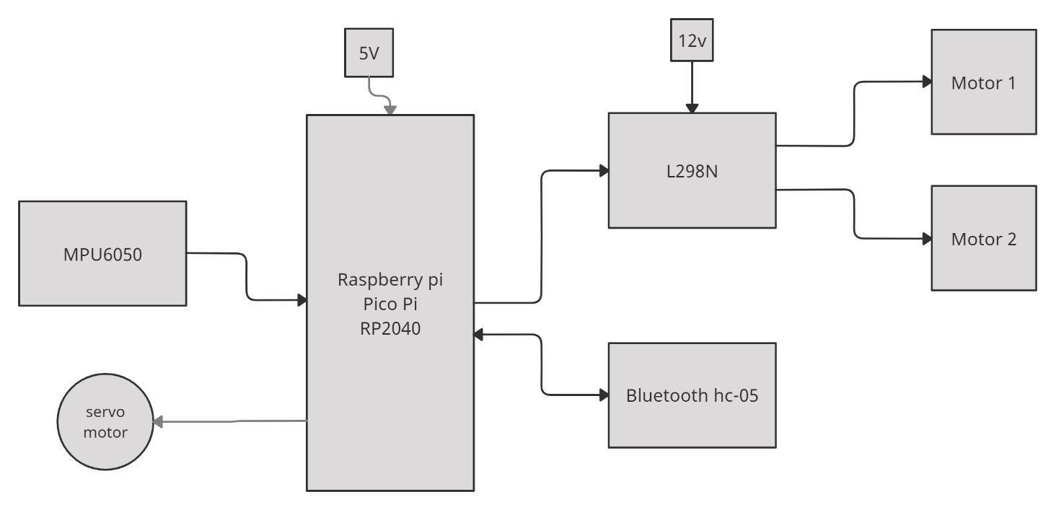
TENTATIVE BLOCK DIAGRAM

Slide 6
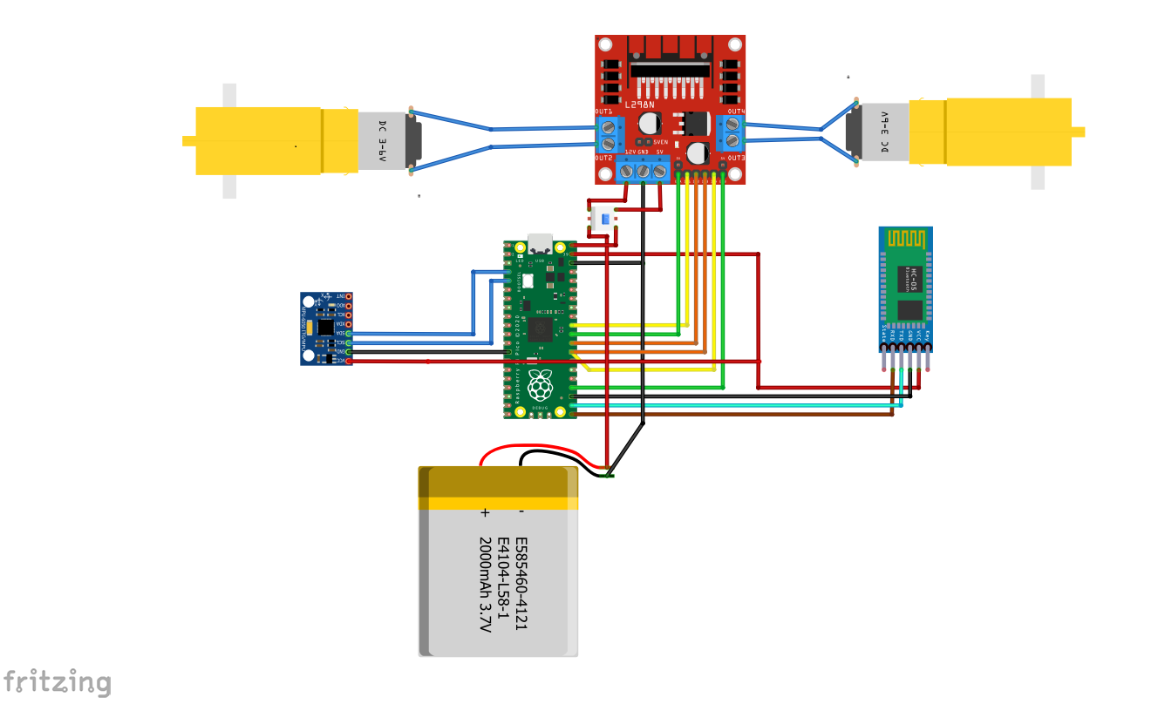
CIRCUIT DIAGRAM
Motor Driver
Motor
Push Switch
Pico PI
Bluetooth
MPU-6050
Battery

Slide 7
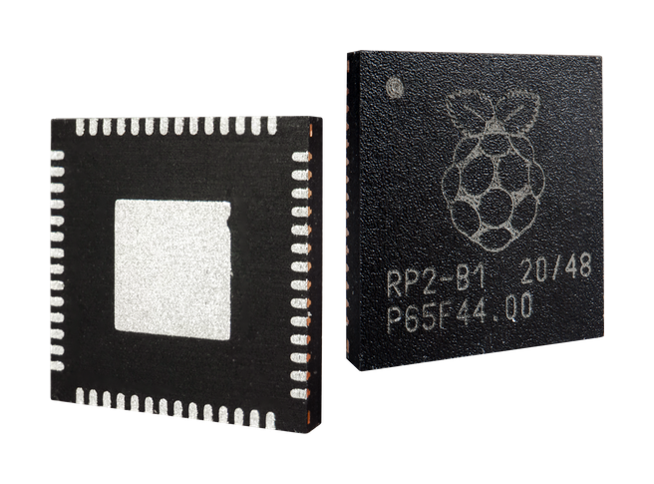
RP2040
Key features:
133 MHz dual ARM Cortex-M0+ cores
Each core has an integer divider peripheral, and two interpolators.
264 KB SRAM in six independent banks
No internal Flash or EEPROM memory (after reset, the boot-loader loads firmware from either external flash memory or USB bus into internal SRAM)
QSPI bus controller, supporting up to 16 MB of external Flash memory
DMA controller
AHB crossbar, fully-connected
On-chip programmable LDO to generate core voltage
2 on-chip PLLs to generate USB and core clocks
30 GPIO pins, of which 4 can optionally be used as analog inputs

Slide 8
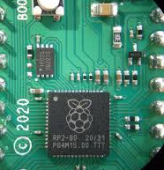
WHAT IS THE MEANING OF RP2040?
The name of the RP2040 microcontroller is made up of 5 sections:
RP in RP2040 means ‘Raspberry Pi’.
2 signifies the number of processor cores the microcontroller has i.e., 2 cores.
0 represents the type of processor core the RP2040 microcontroller has. This processor is called ARM Cortex-M0+ processor. Other microcontrollers of this series by ARM are named as Cortex-M1, Cortex-M3, Cortex-M4, Cortex-M7 etc.
4 means the microcontroller has 264 kilobytes (kB) of RAM. Which is based on a special mathematical function: floor(log2(RAM/16)).
0 simply means there is no non-volatile storage on‑board.

Slide 9
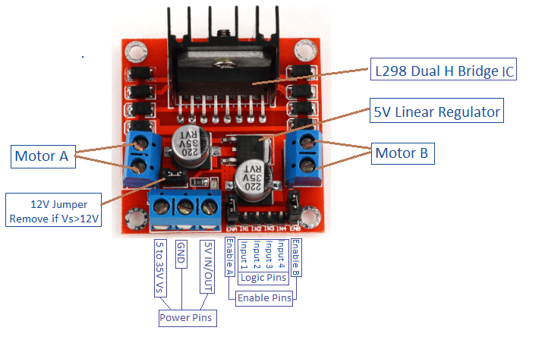
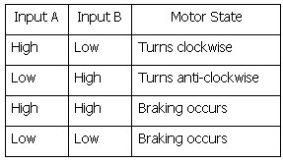
MOTOR DRIVER MODULE-L298N
On the other hand, for controlling the rotation direction, we just need to inverse the direction of the current flow through the motor, and the most common method of doing that is by using an H-Bridge.
An H-Bridge circuit contains four switching elements, transistors or MOSFETs, with the motor at the center forming an H-like configuration.
So if we combine these two methods, the PWM and the H-Bridge, we can have a complete control over the DC motor.

Slide 10
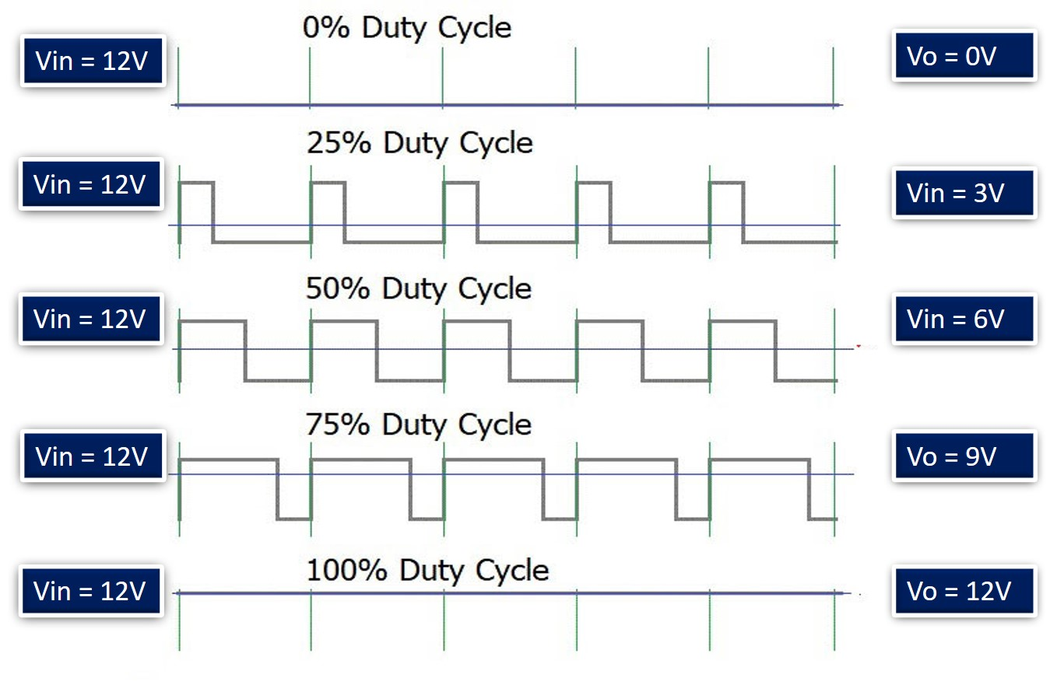
PWM SPEED CONTROL
One method that is often used for DC motor control using a microcontroller is Pulse Width Modulation (PWM) method. The speed of the electric motor depends on the modulator voltage. The greater the voltage, the faster the rotation of an electric motor. PWM is a good technique for controlling analog circuits of the motor drive with digital outputs from a microcontroller.

Slide 11
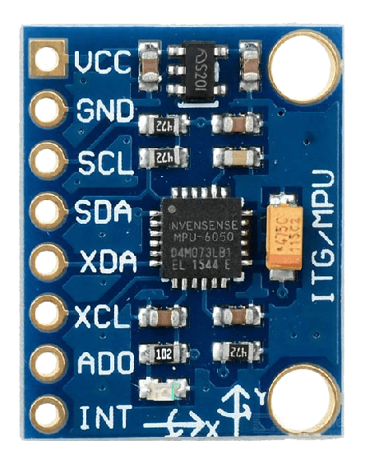
MPU-6050 (Gyroscope)
The MPU-6050 is used to detect the roll angle of the bicycle. It gives values for the change of angle on the z-axle which was used as input for the PID-controller to control the control system.
This module uses the I2C module for interfacing with Pico pi. sensor to control a motion of your Drone, Self Balancing Robot,

Slide 12
H-bridge (L298N)
The term H-bridge is derived from the typical graphical representation of such a circuit. An H-bridge is built with four switches (solid-state or mechanical).
When the switches S1 and S4 (according to the first figure) are closed (and S2 and S3 are open) a positive voltage is applied across the motor.
By opening S1 and S4 switches and closing S2 and S3 switches, this voltage is reversed, allowing reverse operation of the motor.
12

Slide 13
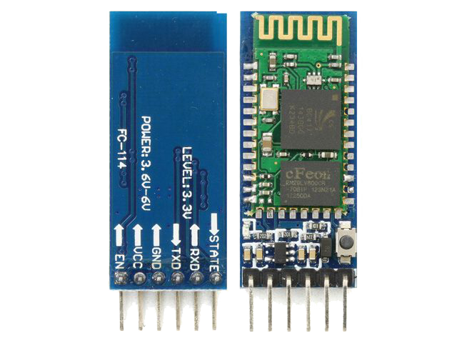
HC-05 BLUETOOTH MODULE
HC-05 is a Bluetooth module which is designed for wireless communication. This module can be used in a master or slave configuration.
Bluetooth serial modules allow all serial enabled devices to communicate with each other using Bluetooth.
It has 6 pins
Key/EN
VCC
GND
TXD
RXD
State

Slide 14
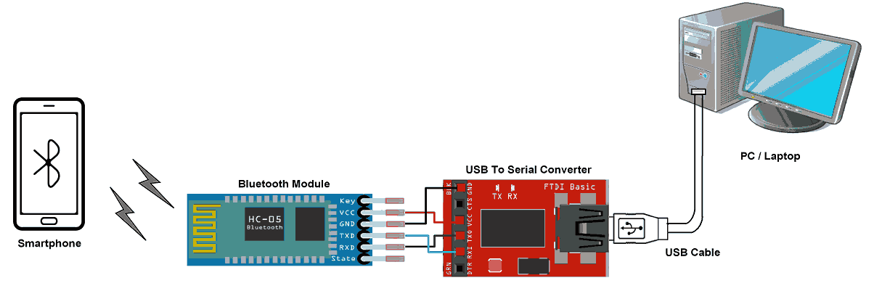
BLUETOOTH COMMUNICATION BETWEEN DEVICES
To communicate smartphone with HC-05 Bluetooth module, smartphone requires Bluetooth terminal application for transmitting and receiving data. You can find Bluetooth terminal applications for android and windows in respective app. store.

Slide 15
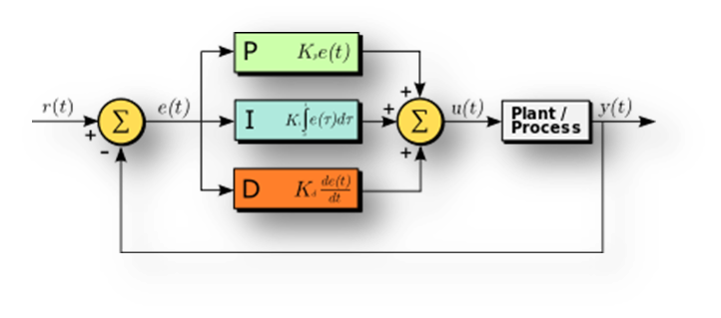
PID-controller
To construct a stable system with a PID-controller, the three components KP, KI and KD need to be tuned right. Proportional integral derivative control (PID) combines the stabilizing influence of the derivative term and the reduction in steady-state error from the integral term.

Slide 16

PID
Proportional
The proportional term produces an output value that is proportional to the current error value. The proportional response can be adjusted by multiplying the error by a constant Kp, called the proportional gain constant.
Integral
The contribution from the integral term is proportional to both the magnitude of the error and the duration of the error. The integral in a PID controller is the sum of the instantaneous error over time and gives the accumulated offset that should have been corrected previously. The accumulated error is then multiplied by the integral gain (Ki) and added to the controller output.

Slide 17


Derivative
The derivative of the process error is calculated by determining the derivative gain Kd. The magnitude of the contribution of the derivative term to the overall control action is termed the derivative gain, Kd.
PID Controller
Proportional-integral-derivative control (PID) combines the stabilizing influence of the derivative term and the reduction in steady-state error from the integral term.

Slide 18
CONCLUSION
The simplest PID controller is applied to balance the bike about the axis and to attain an excellent stability.
There are ongoing researches for development of highly featured control systems & control algorithms for the vertical balancing and to minimize effects of external disturbances, such as wind, sudden crash impact etc.
However, many campus environments also experience traffic congestion, parking difficulties and so a self-balancing bike would be an optimal solution in such cases as it may encourage people to switch to self-balancing two wheelers and further there would be many research & design optimizations so as to develop a pollution free and environment friendly e-bike.
The Self balancing bicycle system can be more useful in future when there is high demand for electric vehicles because of the lack of fossil fuel.
We can also use some advance algorithm which are capable of reading the data from the bike and its surrounding to move itself without human interaction.

Slide 19
REFERENCE
Thanh, B. T. (September 2008), “Balancing control of bicycle robot by particle swarm optimization-based structurespecified H2/H∞ Control”
Jongkil Lee, W. K. Van Moorhem (1996), “Analytical and Experimental Analysis of a Self-Compensating Dynamic Balancer in a Rotating Machanism”,
Beznos A V et al (1998),” Control of autonomous motion of two-wheel bicycle with gyroscopic stabilization”, Robot Autom 3, pp.2670-2675.
Thanh, B. T. (September 2008), “Balancing control of bicycle robot by particle swarm optimization-based structurespecified H2/H∞ Control”
Murata boy and murata girl (2005), http:// www. murata. com/ about/mboymgirl/mboy.
Suprato (May 2006), “Development of a gyroscopic unmanned bicycle”, Master Thesis, Asian Institution of Technology.
Gallaspy, J.M. (1999), “Gyroscopic stabilization of an Unmanned Bicycle”, M.S. Thesis, Electrical Engineering Department, Auburn University, AL.
Thanh, B. T. (September 2008), “Balancing control of bicycle robot by particle swarm optimization-based structurespecified H2/H∞ Control”
Pornnutvuttikul, W. (December 2009), “Performance and robustness analysis of balancing control of a bicycle robot by Fuzzy Sliding Mode control”, Master Thesis, Asian Institution of Technology.
Torkel Glad, Lennart Ljung. Reglerteknik: grundl¨aggande teori. Studentlitteratur, 2006
Pom, Y., L. (17-19 September 2011), “Gyroscopic stabilization of a kid-size bicycle”, The 5th IEEE International
Python code. http://blog.bitify.co.uk/2013/11/reading-data-from-mpu-6050-on-raspberry.html

Slide 20
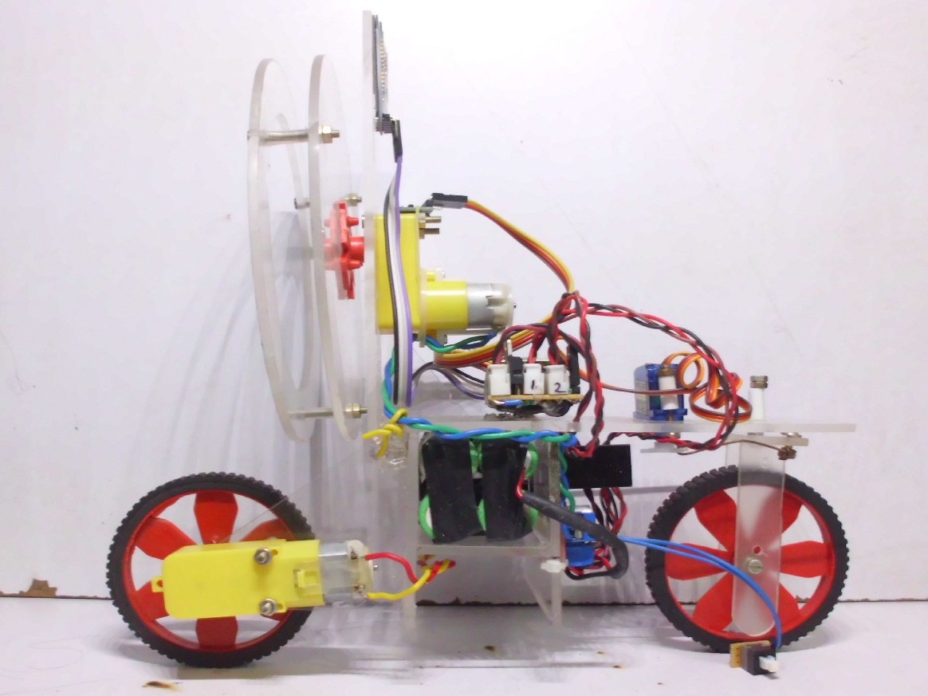
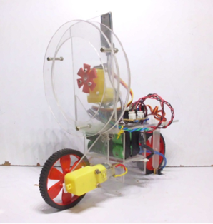
REFERENCE PICTURE

Slide 21
Thanks!
Any questions?
You can find me at:
A. ARI RAM RAJA
M. GOKULA KRISHNAN
P. PREM KUMAR
D. SRIRAM
C. LALITHRAJ

